Slide 1

DHVANI
…THE SPEAK LIFT

Slide 2
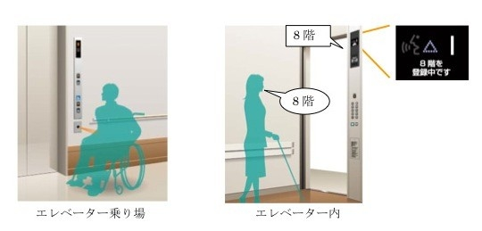
PROBLEM
Stuck in foreign language place
Unsure destination
Specially abled people cannot use the lift comfortably
Additional space and weight of lift man

Slide 3
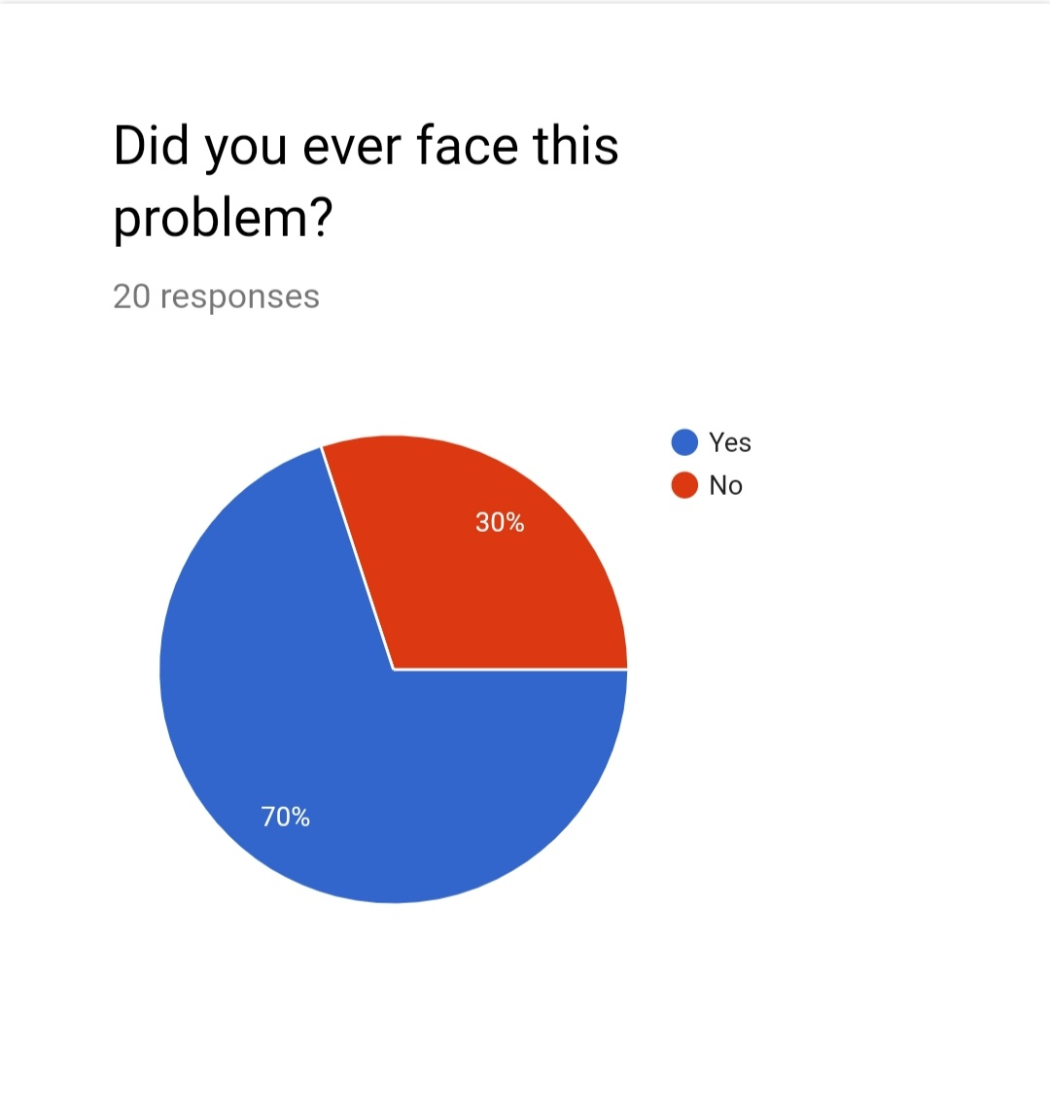

Slide 4
SOLUTION
Utilization of Voice User Interface

Slide 5
OTHER ALTERNATIVES
Indoor Maps are provided
Waiting near the reception
PROBLEM WITH THE CURRENT SOLUTION
No other Route map to Guide towards the Indoor map
Inconvenient for specially abled people

Slide 6
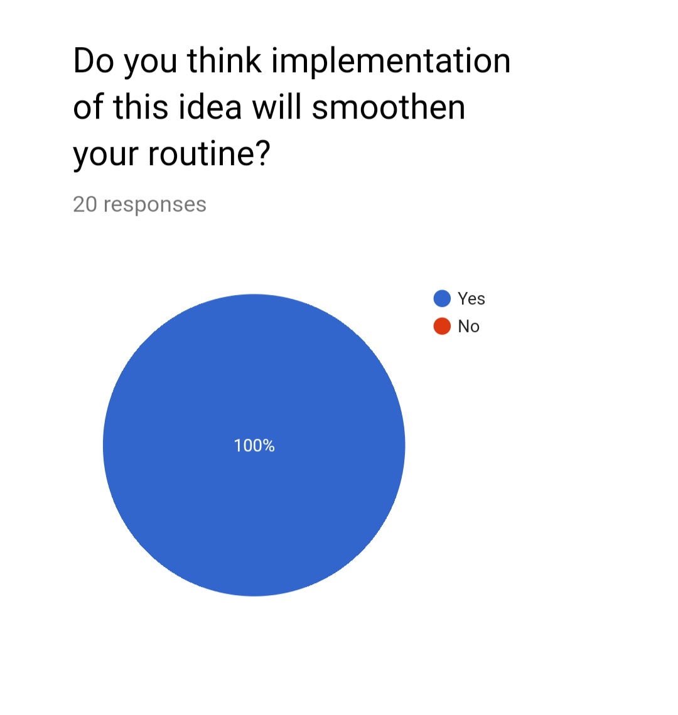

Slide 7
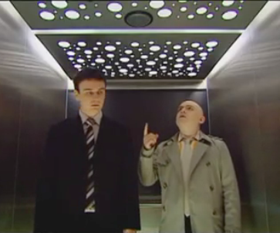
PRODUCT
MICROPHONE
SPEECH PROCCESOR
(with help of GOOGLE translate)
Improvised Elevator logic

Slide 8
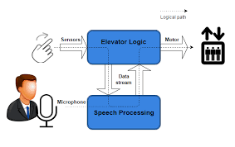
MODEL

Slide 9
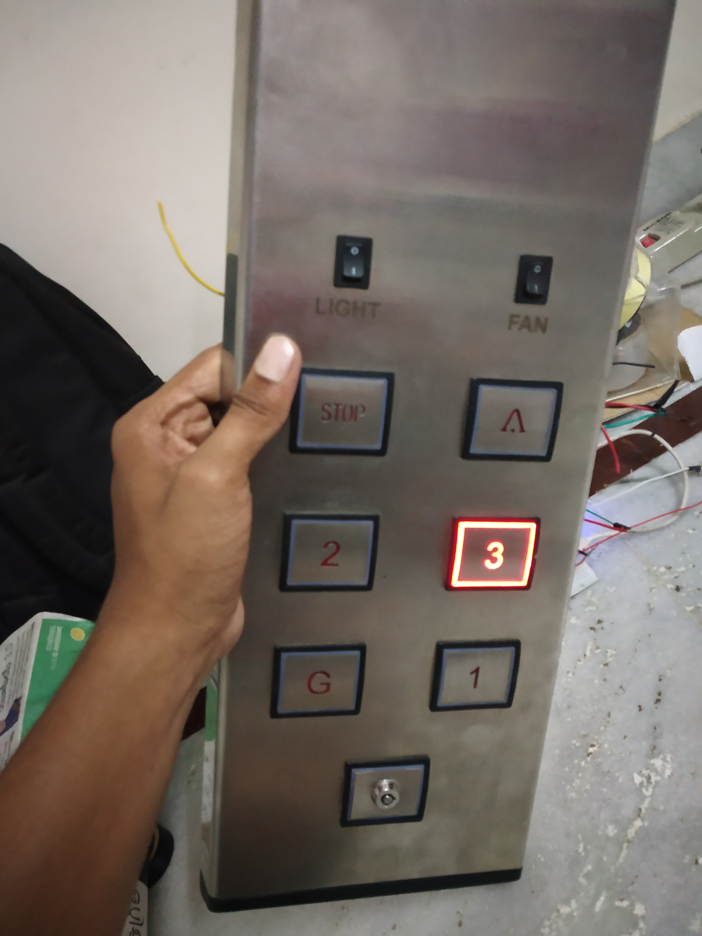

Slide 10
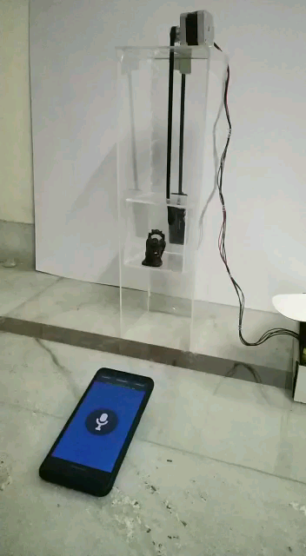

Slide 11
MARKET
MAIN FOCUS ON ELEVATOR BRANDS
AROUND 6000 HOSPITALS IN HYDERABAD

Slide 12
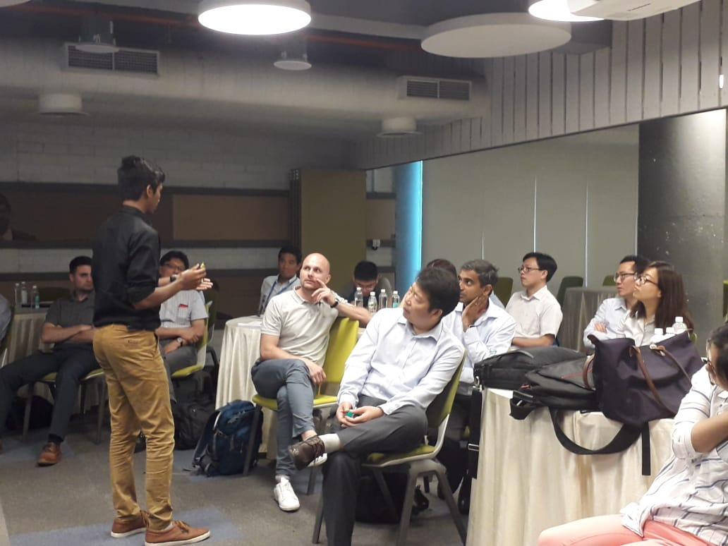
EXCLUSIVE INTERACTION WITH OTIS INTERNATIONAL

Slide 13
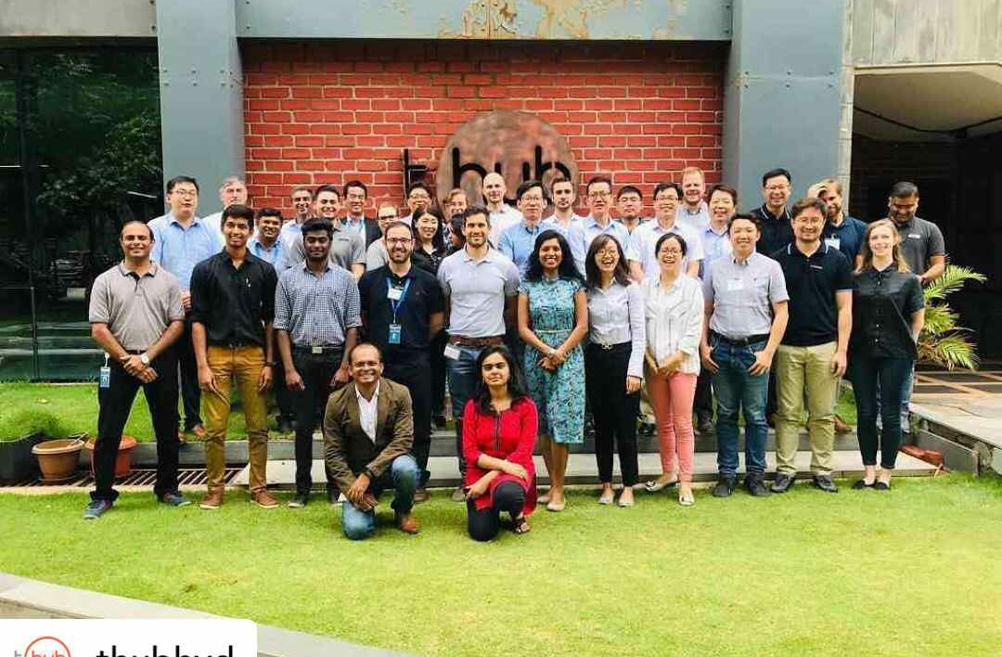

Slide 14
COMPETITION
•SOUND vs TOUCH

Slide 15
REVENUE MODEL
PRICE: 30,000
DHVANI
LIFT MAN

Slide 16
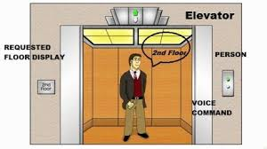
Value Proposition
Voice automation
User friendly experience
Futuristic AI based service

Slide 17
LIMITATIONS AND RISKS
Handling different accents and trends in voice
Difficulty in integration with the older Elevators
Problem when Internet connectivity is low
Can’t they build their own model?

Slide 18
DHVANI
TEAM
L.DHEERAJ
K.HARIPRIYA
S.P.BALA SIRISHA
G.GOWTHAM.

